Slide 1
WHQL Certification

Slide 2
Prepare cab file signed with aaeon dongle(1/4)
Prepare driver file that signed with our aaeon dongle, the driver file include aaeonFramework.inf, aaeonFramework.sys and WdfCoinstaller01009.dll.
Using “Developer Command Prompt for VSXXXX” tool to execute “makecab.ddf” file to create cab file.
Move the driver files and “makecab.dff” file to the same folder.
Open “Developer Command Prompt for VSXXXX” tool.
Enter “makecab /f makecab.ddf” to create “aaeonFramework.cab”.
Signed aaeonFramework.cab with aaeon dongle.
Move “aaeonFramework.cab”, “GlobalSign Root CA.crt” and “signed_file.bat” to the same folder.
Enter “signed_file.bat aaeonFramework.cab”.

Slide 3
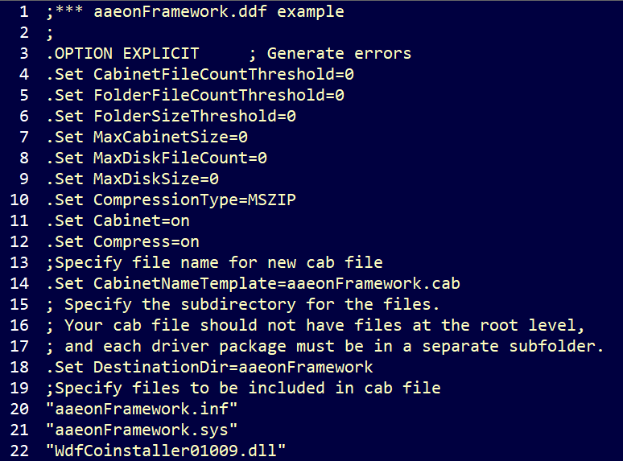
Prepare cab file sighed with aaeon dongle(2/4)
“makecab.ddf” content like below：
“signed_file.bat” content like below:

Slide 4
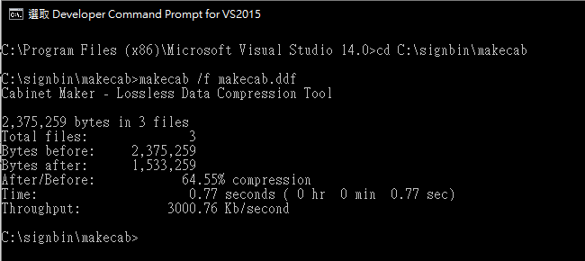
Prepare cab file sighed with aaeon dongle(3/4)
Create aaeonFramework.cab execution result：

Slide 5
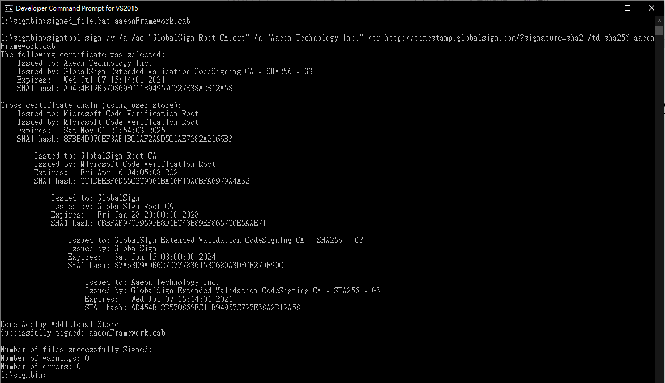
Prepare cab file sighed with aaeon dongle(4/4)
Signed aaeonFramework.cab with aaeon dongle result:

Slide 6
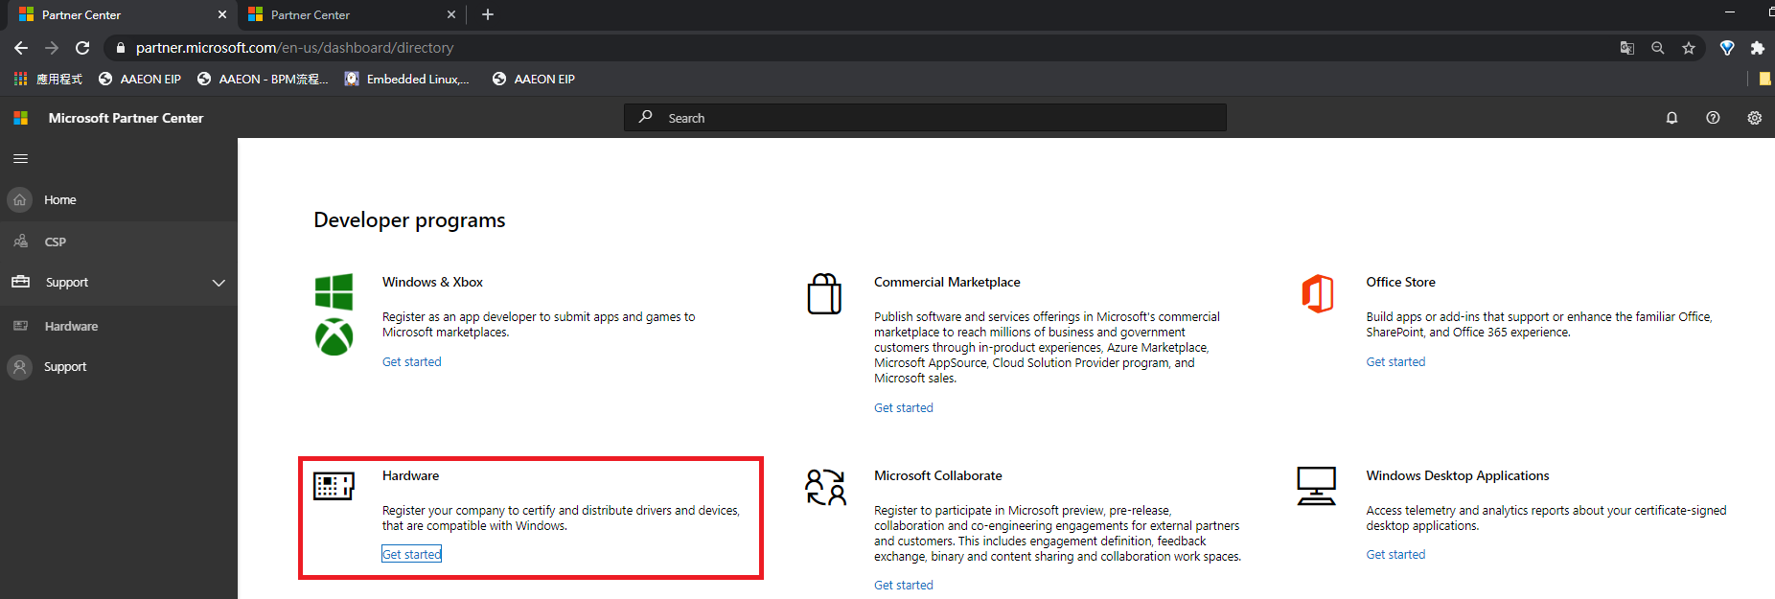
Upload aaeonFramework.cab to Microsoft dashboard
Microsoft dashboard link:
https://partner.microsoft.com/en-us/dashboard/directory
Go to hardware web page.

Slide 7
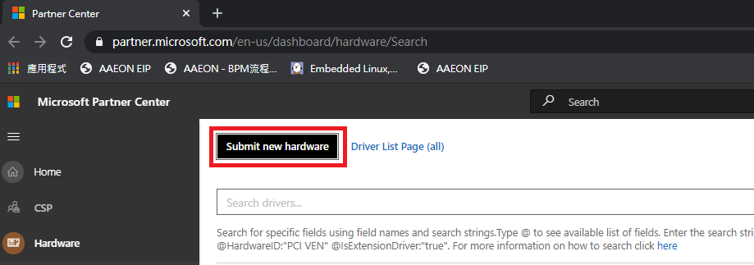
Upload aaeonFramework.cab to Microsoft dashboard
Select “Submit new hardware”

Slide 8
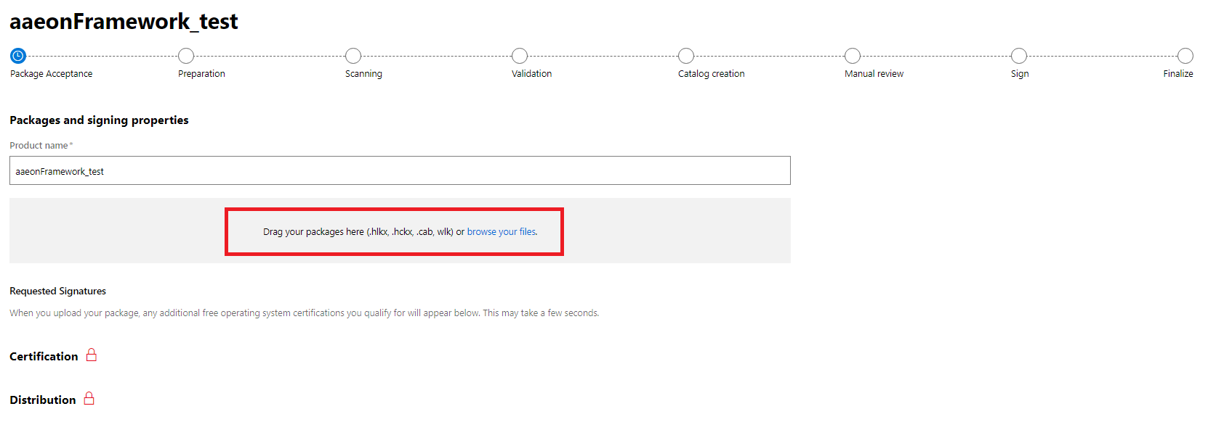
Upload aaeonFramework.cab to Microsoft dashboard
Enter your product name
Upload aaeonFramework.cab

Slide 9
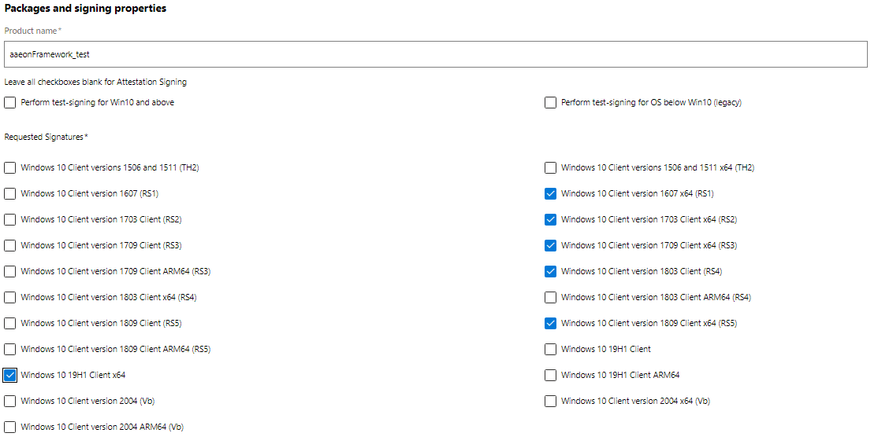
Upload aaeonFramework.cab to Microsoft dashboard
Select your requested signatures and submit.

Slide 10
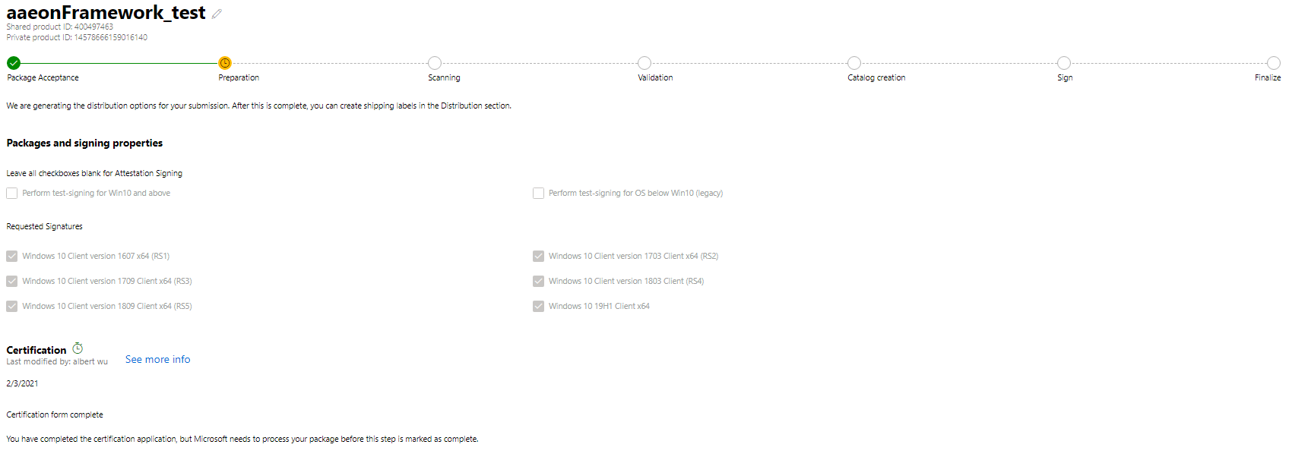
Upload aaeonFramework.cab to Microsoft dashboard
Waiting for the certification to complete.

Slide 11
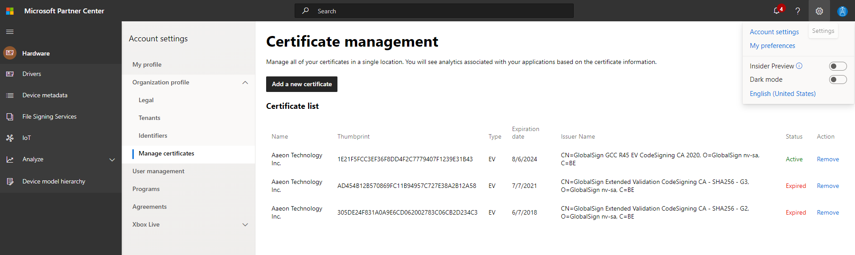
Add new token certificate
If we change a new token , WHQL will need to add a new certificate.
The steps are as follows
1
2
4
3

Slide 12
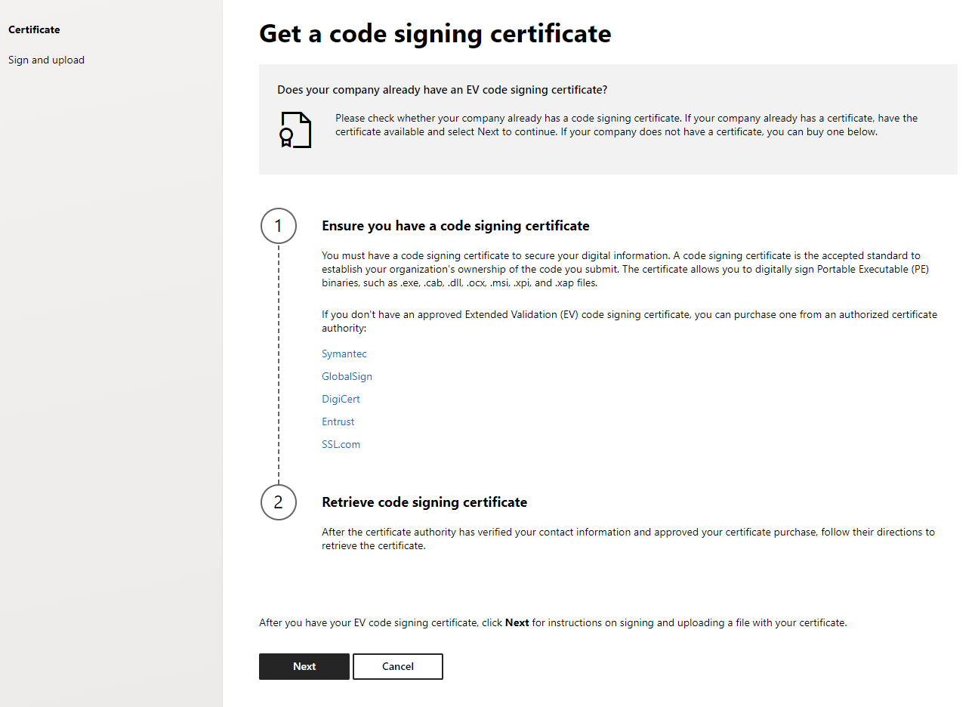
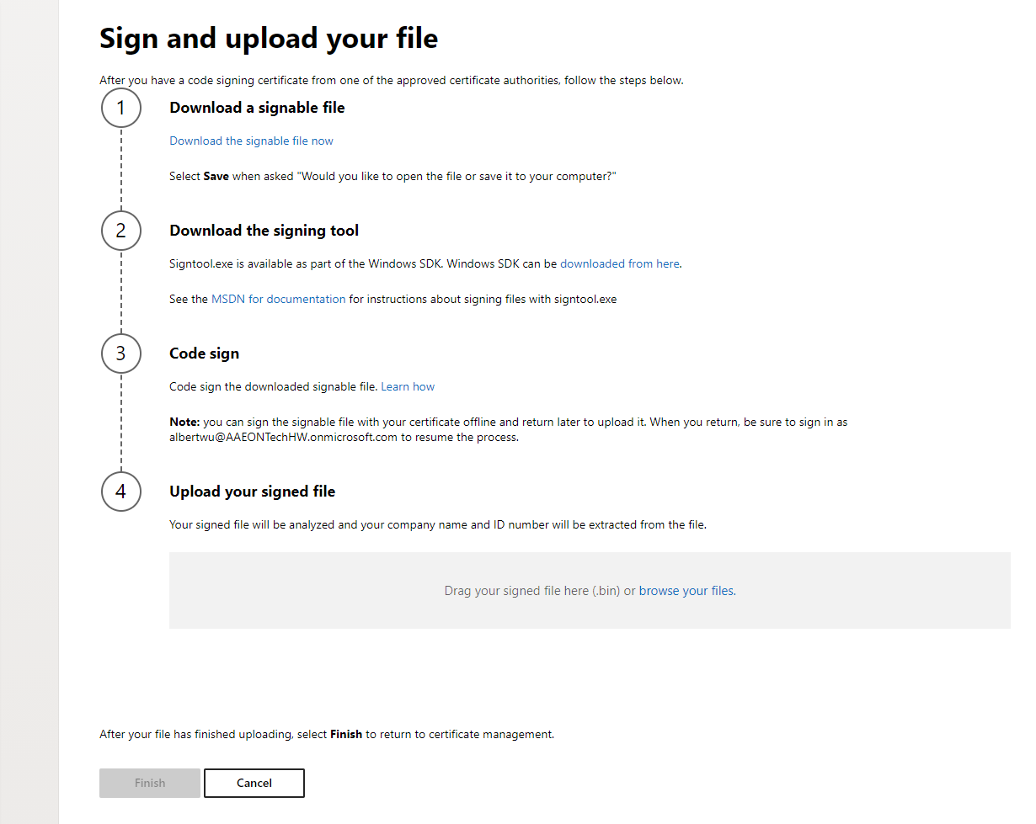
Download SignableFile.bin

Slide 13
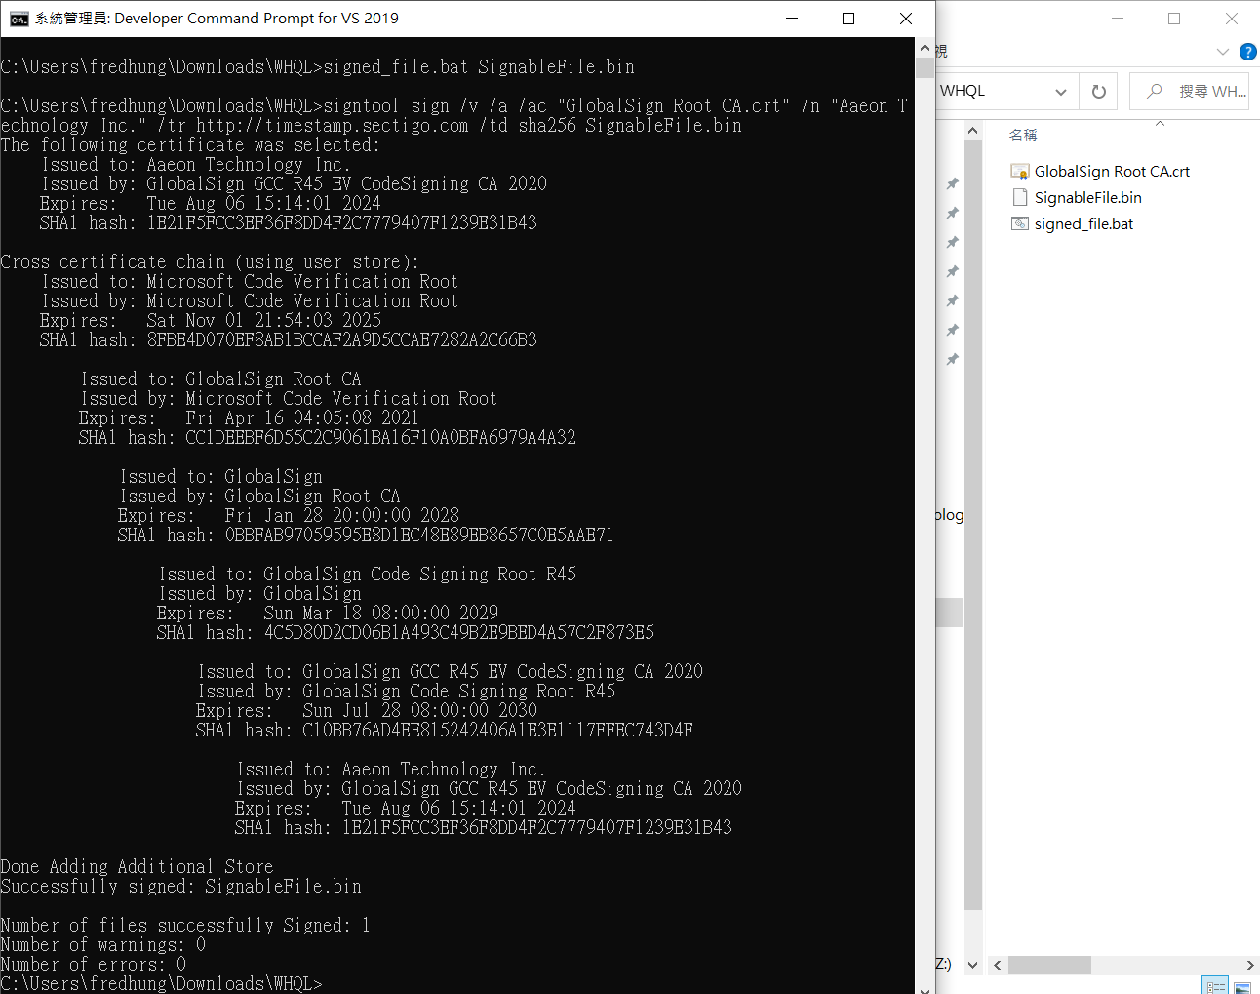
Sign signablefile.bin
Move “SignableFile.bin”, “GlobalSign Root CA.crt” and “signed_file.bat” to the same folder.
Enter “signed_file.bat SignableFile.bin”.
Upload SignableFile.bin
Finish

